Slide 1

Homer’s Guide to Rails
I can teach rails on ruby
DOH!
Ruby on guide. DOH!
Ruby on rails!
Woohoo ruby!

Slide 2


Rails got you feeling?

Slide 3

Homer to the Rescue
I’m smrt!
Don’t worry! Smart Homer is here te help.
He’ll guide you through the inner workings of Rails.
Just follow his head!

Slide 4

Ooo New post
In the Beginning
Welcome to
Homer Space
New post
Dougnut Pictures
Call Sick to Work
Annoy Flanders

Slide 5




New Article Form
NEW POST
LOADING
...
Title:
Content:
Submit.
Internet
infrastructure
NEW
action
GET
Server
NEW
view

Slide 6
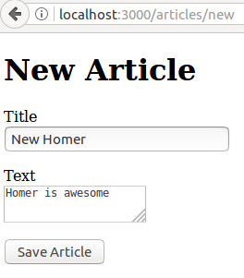
POSTing a Article
http://www.homer.me/articles/new
<form action="/articles" method="post">
Title:
Content:
Submit.

Slide 7
Routing a Article
Submit.
config/routes.rb
Params: {"article"=>
{"title"=>
"New Homer",
"text"=>"Homer is awesome"}}
/articles
POST

Slide 8
Controlling a Article
app/controller/articles_controller.rb
articles#create
def create
Params: {"article"=>
{"title"=>
"New Homer",
"text"=>"Homer is awesome"}}
@article =
params.require(:article).permit(:title, :text)

Slide 9

Modelling a CREATE
app/model/article.rb
Article.new
(Params[:article])
Params: {"article"=>
{"title"=>
"New Homer",
"text"=>"Homer is awesome"}}
@article

Slide 10
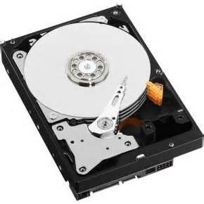
Saving an article
app/model/article.rb
Save to DB
@article
.save
redirect_to @article
app/controller/articles_controller.rb

Slide 11
SHOWing article
app/controller/articles_controller.rb
def show
config/routes.rb
@article =
Article.find(params[:id])
redirect_to @article
article GET /articles/:id(.:format) articles#show
Article.find(params[:id])

Slide 12
Viewing a SHOW
app/model/article.rb
Finding object
Article.find
(params[:id])
@article
app/controller/articles_controller.rb

Slide 13
Viewing a SHOW
Internet
infrastructure
app/views/articles/show.html.erb
<p> <strong>Title:</strong>
<%= @article.title %></p>
<p> <strong>Text:</strong>
<%= @article.text %> </p>
@article
app/controller/articles_controller.rb

Slide 14
Ooo interwebs!
In the End
Welcome to
Homer Space
Title: New Homer
Text: Homer is awesome.

Slide 15

Happy Homer

Slide 16
In Summary
Follow your routes
to controller actions
Form data is saved in
params object that
needs to be called
Instance variables are
used in view but need
to reference content
properly
Have fun with it!

Slide 17

Happier Homer

